Slide 1
Adoption of Merit-Based Student Grant Programs: An Event History Analysis
William R. Doyle
2006
https://www.jstor.org/stable/4121783

Slide 2
Main focus of the study
As of 2005, 15 states had adopted a broad-based merit aid program, providing a combined $1.2 billion for college students on the basis of academic qualifications. This represents a shift away from a long tradition of need-based aid at the state and federal levels. This article utilizes a Cox proportional hazards model to analyze states' characteristics that are associated with their probability of adopting a merit aid program. Lower levels of college continuation and educational attainment are found to increase the hazard for a state's adoption of a merit aid program, whereas higher levels of student out- migration decrease the proportional hazard for a state's adoption of such a program.

Slide 3
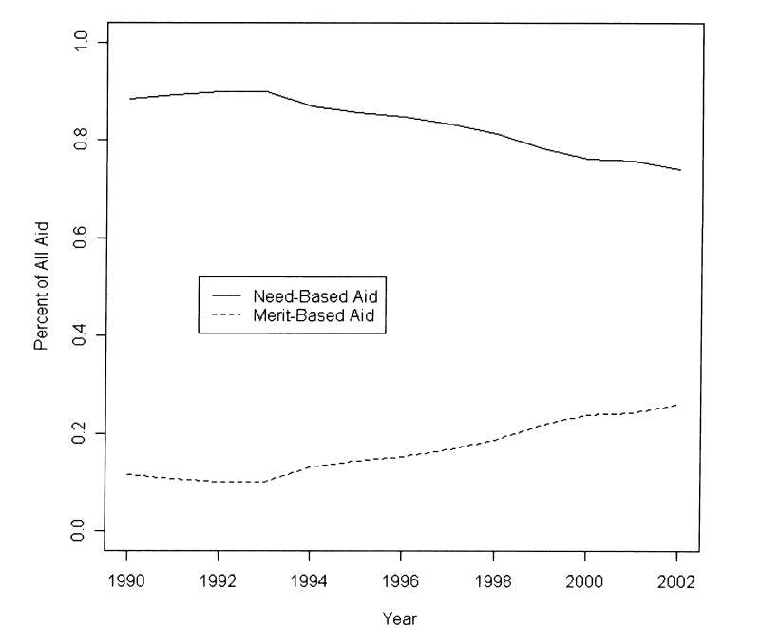
Student Aid
Between the 1990’s and the early 2000’s the provision of aid was gradually changing from need based to merit based.
The study proposed the hypothesis that if a nearby state switch to a merit-based system, then they would be more likely to switch.
Was this true?

Slide 4
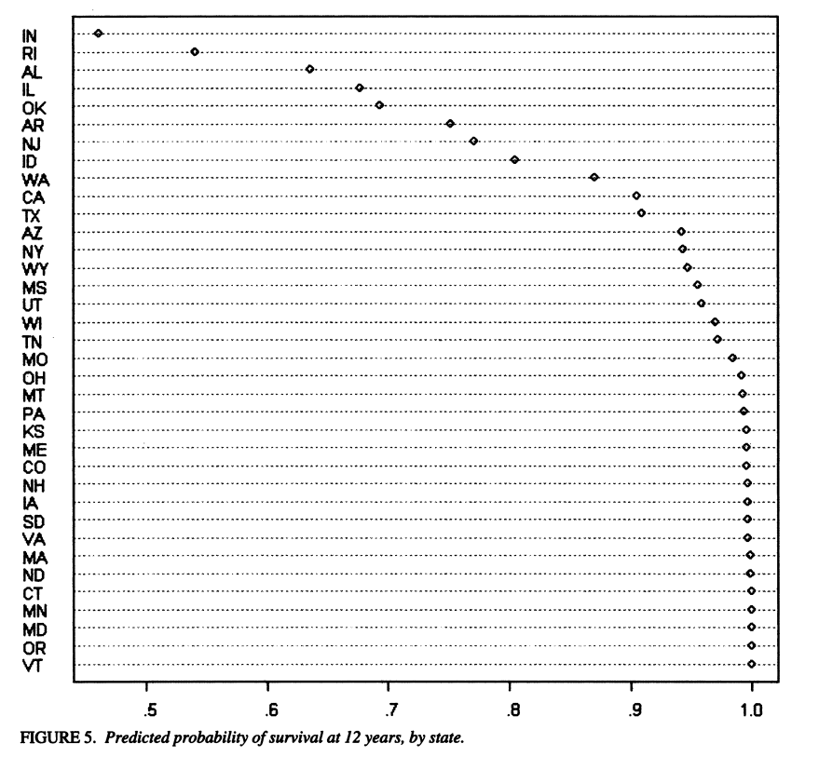
Who has implemented the merit scholarships?
The figures indicate that states which are immediately adjacent to states with merit-based programs are negatively correlated with adopting the program for themselves.
It was found that states which have lower overall attainment and continuation rates are more likely to adopt a merit-based program.

Slide 5
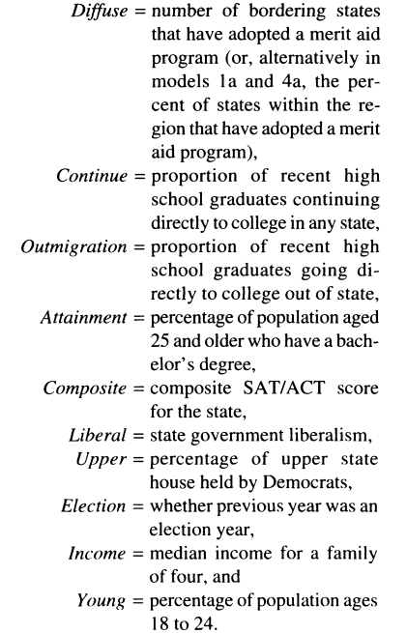
Data and abbreviations
The dependant variable is the year of adoption of a merit aid program

Slide 6
Lets check their modelling assumptions
First I will look at the residuals and see how they are distributed.
I will then run a Poisson model to check if the results differ from the results of the study.

Slide 7
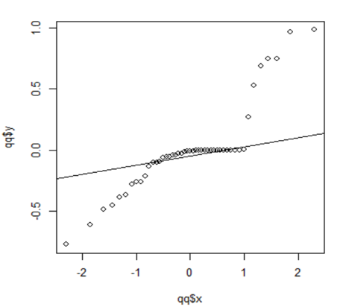
Checking the Residuals
Using a qq line test in R I checked the residuals
`
I then plotted them and it shows that it is mostly normally distributed but has some outliers.
res1 <- residuals(par.all)
qqline(res1)

Slide 8
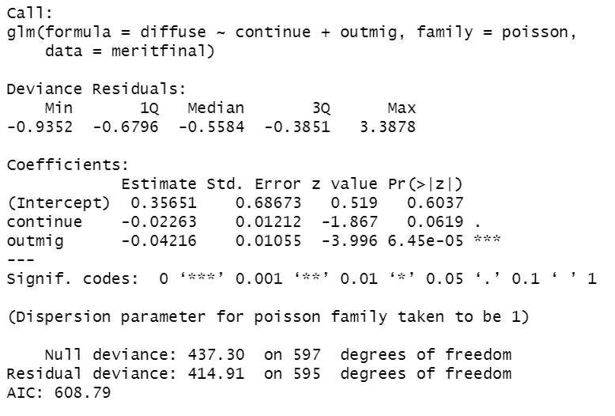
Running a Poisson model
To test if continuing education or outward migration influenced diffusion of merit-based scholarships, I ran a Poisson model.
The model showed that an increase in continuing education did not have a significant effect on diffusion.
It also showed that outward migration has a very small p-value and is likely to be a significant indicator of adoption of merit-based scholarships.

